Slide 1
A Place to Be

Slide 2
To Be Free

Slide 4
To Be Questioning

Slide 5
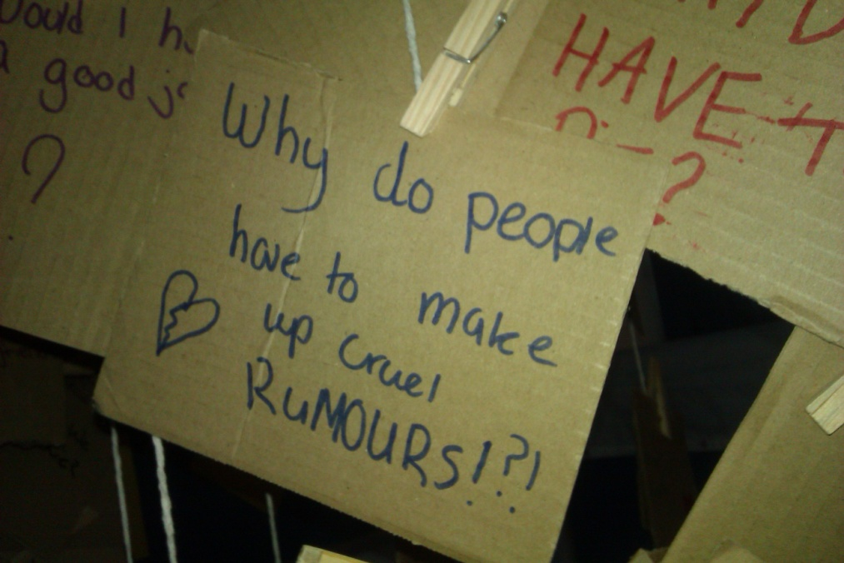

Slide 6
To be myself

Slide 7
To be remembering

Slide 8
To be Compassionate

Slide 9
To be forgiven

Slide 10
To be Thankful

Slide 11
To be Hopeful

