Slide 1
World Mission Remit: To bring important issues affecting World Church to Presbytery’s attention

Slide 2
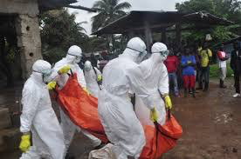
World Mission Remit: To bring important issues affecting World Church to Presbytery’s attention
Continue to pray for Christian Aid and the other organisations involved in dealing with the Ebola Crisis
Pray for the safety of the medical staff who are dealing with those suffering from Ebola

Slide 3
World Mission Remit: To bring important issues affecting World Church to Presbytery’s attention
Please pray for
Middle East and Jerusalem
Short family at Tabeetha School Visiting Hamilton Presbytery next month
Peace and forgiveness to triumph over violence
Kwahu Presbytery – Paa retires after 5 years as chairman (Moderator) of Kwahu Presbytery
Yesterday was World Aids Day – please encourage churches to do a Souper Sunday in January

