Slide 1
Department for International Development
Notes:
The Department for International Development (DFID) leads the UK’s work to end extreme poverty

Slide 2
Presentation to: World Church Committee, Hamilton Presbytery
Presented by:
Les Campbell – Director for Value for Money
Bash Hussain – Conflict, Humanitarian and Security Department
19th April 2016

Slide 3
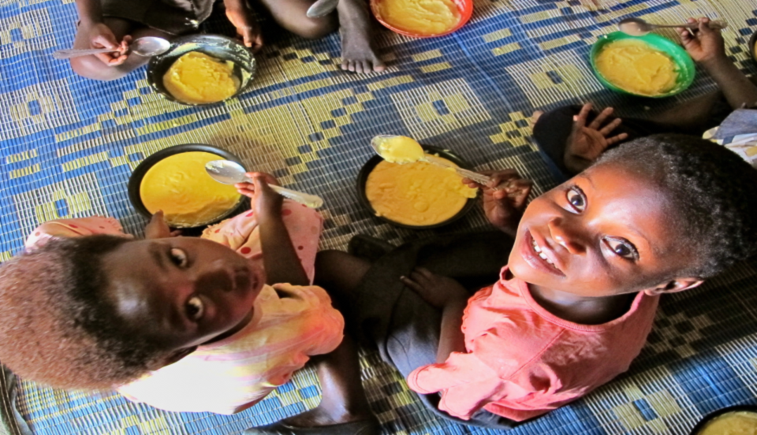
Contents
Introduction to DFID
The work of DFID
Conflict & Fragility
Notes:
Content Page for entire slide pack if used

Slide 4
Key Figures
Total UK Aid 2015: £12,239 million
DFID spends: £9,767 million

Slide 5
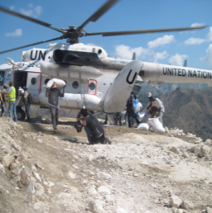
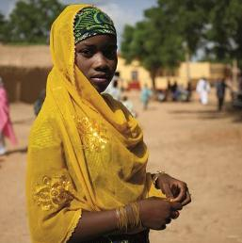
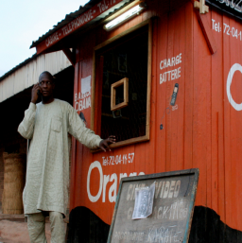
The Department for International Development (DFID) leads the UK’s work to end extreme poverty around the world. We are:
About DFID
Leading in emergencies
Unleashing the full potential of girls and women
Ending aid dependency through jobs
Notes:
DFID’s key priority areas are: leading in humanitarian assistance, ending aid through growth and empowering women and girls.
Leading in Emergencies-
As a country, Britain has never stood on the sidelines and we will continue to lead in humanitarian emergencies, providing urgent assistance to those in need.We will scale up our work in Syria and neighbouring countries to deal with the largest humanitarian disaster of our generation, shifting to a longer term, more strategic approach
Unleashing the full potential of girls and women-
No country can develop with only half their population involved, so we will support girls and women.We will scale up programmes to prevent violence against women and girls, including in humanitarian situations and in conflict
Ending aid dependency through jobs-
We will use smart aid to focus relentlessly on ending the developing world’s dependency on aid through jobs and economic growth.
We will invest in programmes that build businesses and create markets.
We will partner with UK businesses to help them join the development push and invest responsibly in the developing world.

Slide 6
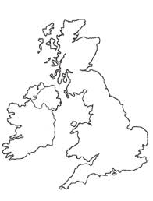
Our UK Headquarters
2 UK headquarters: London and East Kilbride
2,800 staff based in two UK headquarters and over 20 overseas offices.
East Kilbride
London

Slide 7
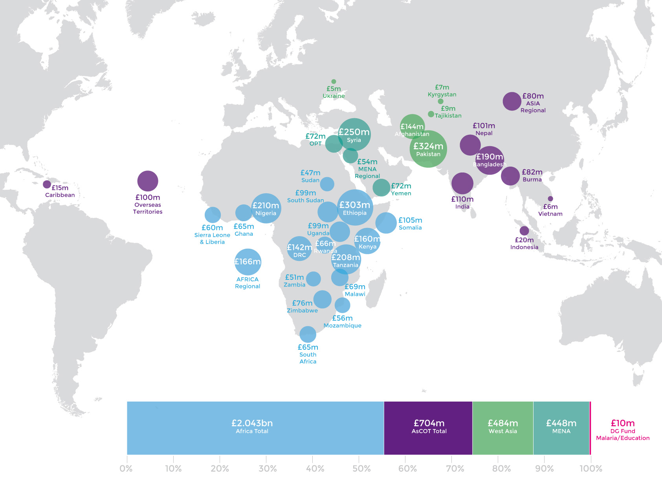
DFID’s bilateral geographic portfolio in 2015/16
Notes:
DFID priority countries are chosen to support the countries where aid will make the biggest difference.
List of 28 High priority DFID Countries:
Afghanistan, Bangladesh, Burma, Congo, Dem. Rep, Ethiopia, Ghana, Kenya, Kyrgyzstan, Liberia, Malawi, Mozambique, Nepal, Nigeria, Pakistan, Occupied Palestinian Territories, Rwanda, Sierra Leone, Somalia, South Sudan, Sudan, Tajikistan, Tanzania, Uganda, Yemen, Zambia, Zimbabwe. Both India and South Africa are included in the priority countries but no additional funding will be given to their programmes and all aid will be phased out by 2015.

Slide 8
DFID footprint overview
28 priority countries
Additional DFID staff in Embassies in Brazil, China, Colombia, Indonesia, Libya and UAE and seconded to posts in Tunisia, Egypt, Lebanon and Jordan.
Transitions to our aid programmes underway in India, Vietnam and South Africa
Regional programmes in Africa, Asia, Middle East and North Africa and the Caribbean
Development relationships with three Overseas Territories - Montserrat, Pitcairn and St Helena
Humanitarian aid provided according to need (e.g. for Iraq, Syria, the Sahel and Libya).
Notes:
Transition also in Ghana?

Slide 9
28 DFID priority countries
UK
Pakistan
Nepal
China
Palestine
Afghanistan
Sudan & South Sudan
India
Vietnam
Burma
Ghana
Yemen
Sierra Leone
Nigeria
Ethiopia
Somalia
Cambodia
DR Congo
Tanzania
Kenya
Bangladesh
Liberia
Uganda
Indonesia
Rwanda
Zambia
Malawi
Zimbabwe
Mozambique
South Africa
Lesotho
Notes:
28 priority countries
21 are fragile or conflict-afflicted states (FCAS)
DFID priority countries are chosen to support the countries where aid will make the biggest difference, comparative advantage, basis of need.
List of 28 High priority DFID Countries:
Afghanistan, Bangladesh, Burma, Congo, Dem. Rep, Ethiopia, Ghana, Kenya, Kyrgyzstan, Liberia, Malawi, Mozambique, Nepal, Nigeria, Pakistan, Occupied Palestinian Territories, Rwanda, Sierra Leone, Somalia, South Sudan, Sudan, Tajikistan, Tanzania, Uganda, Yemen, Zambia, Zimbabwe. Both India and South Africa are included in the priority countries but no additional funding will be given to their programmes and all aid will be phased out by 2015.
The largest country programme was Ethiopia, with expenditure of £284.4 million.

Slide 10
Government Spend by Department
Notes:
For reference: UK government bailed out RBS and Lloyds with £65 billion; and provided £1 trillion of cash and guarantees to the banking sector

Slide 11
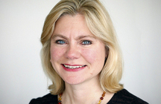
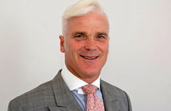
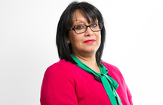
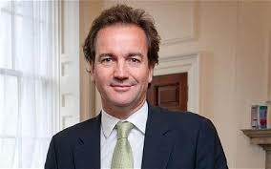
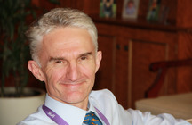
Management
Secretary of State
Rt Hon Justine Greening MP
Minister of State
Rt Hon Desmond Swayne MP
Parliamentary Under
Secretary of State
Baroness Verma
Parliamentary Under
Secretary of State
Nick Hurd MP
Permanent Secretary
Mark Lowcock
Notes:
Management team

Slide 12
New UK Aid Strategy (1)
Published in November 2015
UK as an international player and leader
The right thing to do - morally, socially
The smart thing to do - in our national interest
Committed to acheieve the government’s target of spending 0.7% of gross national income (GNI) on Aid.
Greater focus on results-based aid, accountability and transparency.
Notes:
Justine Greening, “Britain won't stand on the sidelines. We are striving for the world we want. “
-Morally the right thing to do
-Socially develop our world
Aid is in our national interest
year, 6 out of the 15 fastest growing economies were in Africa.
-“Investment in international development is also in our national interest. Trade between nations creates growth, jobs and prosperity for both countries and people – ending aid dependency and creating the UK export markets of the future. "Every time Britain has been at its most successful, it’s been when we’ve been out in the world, trading, doing business, and shaping the world we want. Our country has never stood on the side-lines, and we can’t afford to start now.”
Domestic economic pressures place a special focus on DFID activities
We have to perform at an exemplary level,

Slide 13
New UK Aid Strategy (2)
Four objectives:
Strengthening global peace, security and governance
Strengthening resilience and response to crises
Promoting global prosperity
Tackling extreme poverty and helping the world’s most vulnerable
Ensuring Value For Money, leveraging UK expertise and meeting International Development Act and OECD rules on Overseas Development Assistance (ODA).

Slide 14
Spending Review
The Spending Review, November 2015, set out that the UK ODA budget will grow over the four-year period from around £12 billion in 2015/16 to over £15 billion in 2019/20.
DFID will spend around 72% of the ODA between 15/16-19/20
Other government departments such as BIS, FCO and DoH have been allocated 16% of ODA available over the 4 years.
Balance is allocated to joint cross-government funds

Slide 15
Results - four years to March 15
Health – ensured that 5.1 million births took place safely with the help of nurses, midwives or doctors
Water, sanitation and hygiene – supported 62.9 million people, of whom 22.2 million were women, to access clean water, better sanitation or improved hygiene conditions through DFID’s WASH programmes
Humanitarian assistance – reached over 13 million people with emergency food assistance, including 5.5 million women or girls, through DFID support
Governance and security – supported freer and fairer elections in 13 countries in which 162.1 million people voted
Climate change – supported 14.6 million people to cope with the effects of climate change
Notes:
Achievements by 2014-15 – towards its commitments for 2011-15 as set out in DFID results framework

Slide 16
75% of our humanitarian assistance goes to conflict-affected areas
Notes:
In Kenya - over a 20 year period - every $1 spent on disaster resilience resulted in $2.90 saved in the form of reduced humanitarian spend, avoided losses and development gains

Slide 17
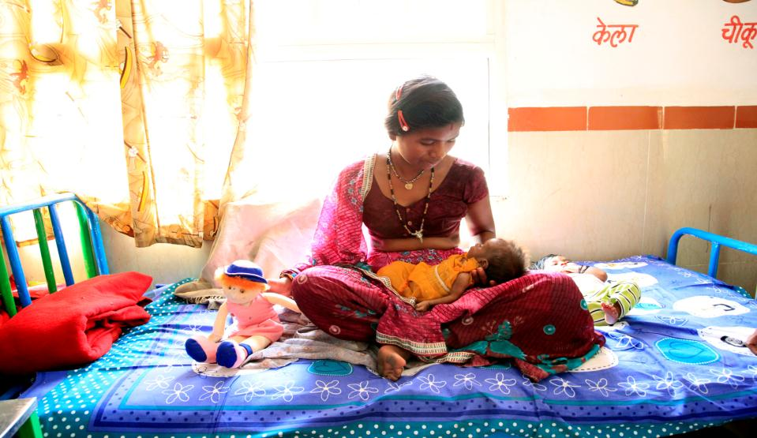
Each year, more than one third of a million women and girls die in pregnancy or childbirth. Some 60 million women give birth not in a health facility. 50 million of them give birth without skilled care.

Slide 18
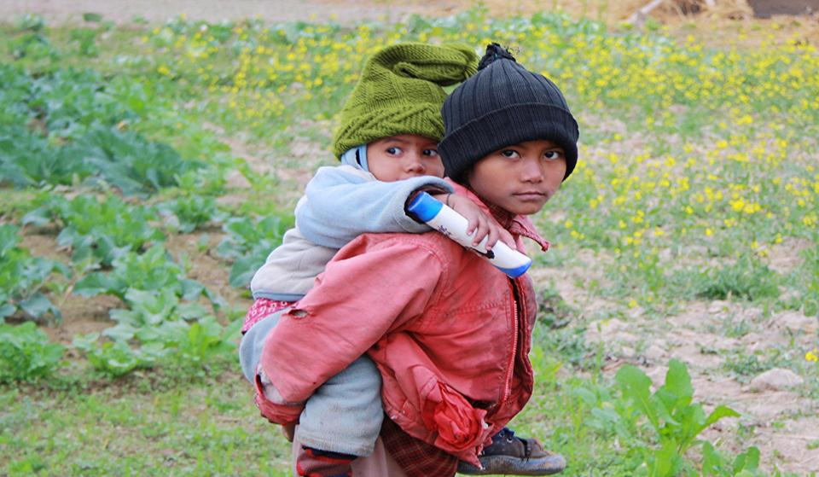
101 million children do not have access to education, 78 million of these are girls

Slide 19
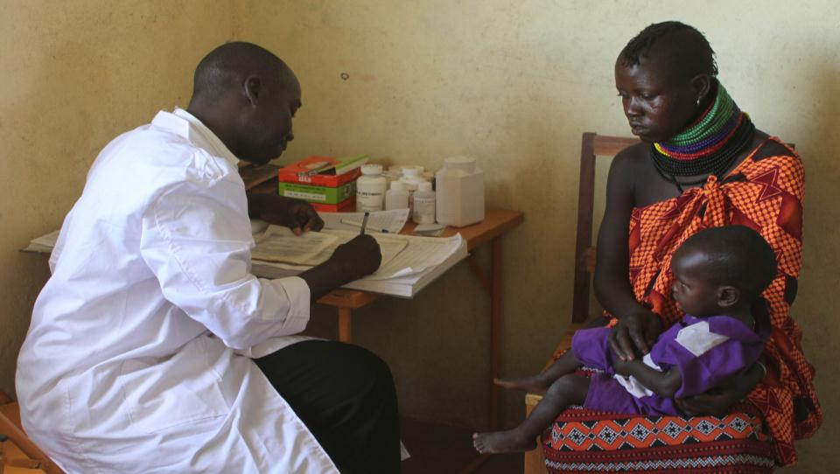
33 million people worldwide still live with HIV and do not have access to medication

Slide 20
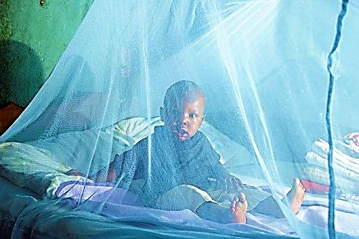
Malaria is the ninth most common cause of death and disability globally and the fifth largest cause of death from infectious diseases.
Notes:
Why Does the UK give international Aid?

Slide 21
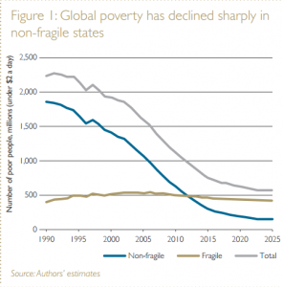
Conflict and stability
War = development in reverse
Fragile countries account for 1/3 of those in extreme poverty
Over 60 million refugees 2015
Financial cost of crisis:
£1 prevention vs. £4 response
Notes:
Human cost of conflict:
People in conflict: twice as likely to be undernourished, 50% more likely to be impoverished; three times as likely to be out of school.
Women and girls often worst affected.
Impact on poverty:
Average cost of civil war = 30 years’ economic growth.
Average of 14 years for post-conflict country to return to previous growth path and 20 years to previous trade levels
Far most cost-effective to invest in conflict-prevention then to respond once conflict has broken out (£1/£4)
DFID is scaling up its work in fragile and conflict-affected states:
Geographically – 21 out of 28 priority countries are fragile or conflict-affected states
Financially – we have committed to spend 30% of ODA in these environments.
This focus will allow us to deliver results that will reduce conflict and help build stability overseas. For example, we will:
- Support freer and fairer elections in 13 countries with more than 300 million voters
- Help 10 million women to access justice through the courts, police and legal assistance
- Support 40 million people to hold authorities to account

Slide 22
Why does the UK give aid?
UK as international player and leader
It is the right thing to do
Morally
Socially
It is the smart thing to do
It is in our interest
We are an open economy
Notes:
Justine Greening, “Britain won't stand on the sidelines. We are striving for the world we want. “
-Morally the right thing to do
-Socially develop our world
Aid is in our national interest
-FAQ-Last year, 6 out of the 15 fastest growing economies were in Africa.
-“Investment in international development is also in our national interest. Trade between nations creates growth, jobs and prosperity for both countries and people – ending aid dependency and creating the UK export markets of the future. "Every time Britain has been at its most successful, it’s been when we’ve been out in the world, trading, doing business, and shaping the world we want. Our country has never stood on the side-lines, and we can’t afford to start now.”
We are an open economy:
-UK is an open economy and open society so must address problems that can affect us too
Communicable diseases, threat of pandemics
Security, asylum and migration
Climate and environmental degradation
Illicit financial flows, war against drugs

Slide 23
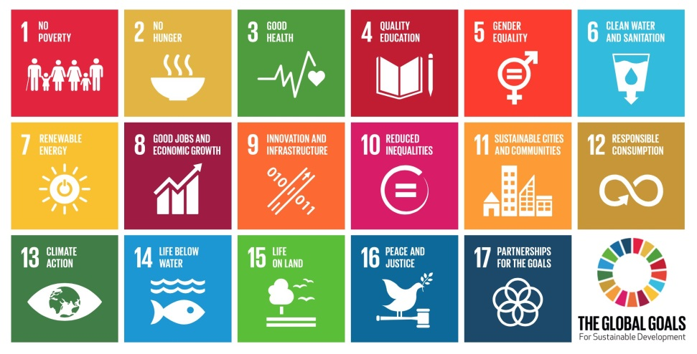
Global Goals
Agreed at the UN in September 2015. Five big shifts required to eliminate poverty by 2030:
1. Leave No One Behind
2. Put Sustainable Development at the core
3. Transform economies for jobs and inclusive growth
4. Build peace and effective, open and accountable institutions for all
5. Forge new global partnerships
Notes:
In 2012, the UN Secretary-General announced a 27 member panel to advise on the global development framework beyond 2015, the target date for the Millennium Development Goals.
1. Leave No One Behind. The aim for after 2015 is to finish the job of the millennium development goals and move from reducing to ending extreme poverty, in all its forms. We should ensure that no person – regardless of ethnicity, gender, geography, disability, race or other status – is denied universal human rights and basic economic opportunities.
2. Put Sustainable Development at the Core. We need to integrate the social, economic and environmental dimensions of sustainability. This includes acting now to slow the alarming pace of climate change and environmental degradation, which pose unprecedented threats to humanity. By mobilising social, economic and environmental action together we eradicate poverty irreversibly.
3. Transform Economies for Jobs and Inclusive Growth. This requires a profound economic transformation to end extreme poverty and improve livelihoods. A profound economic transformation can end extreme poverty and improve livelihoods, by harnessing innovation, technology, and the potential of business. The aim is to ensure good job possibilities while moving to the sustainable patterns of work and life that will be necessary in a world of limited natural resources.
4. Build Peace and Effective, Open and Accountable Institutions for All. Freedom from conflict and violence is the most fundamental human entitlement, and the essential foundation for building peaceful and prosperous societies. We need a transparency revolution, so citizens can see exactly where and how taxes, aid and revenues from extractive industries are spent.
5. Forge a New Global Partnership. A new spirit of solidarity, cooperation, and mutual accountability must underpin the post-2015 agenda. This new partnership should be based on a common understanding of our shared humanity, based on mutual respect and mutual benefit. It should be centered around people, including those affected by poverty and exclusion, women, youth, the aged, disabled persons, and indigenous peoples. It should include civil society
At the Sustainable Development Summit on Friday 25 September, UN Member States adopted the 2030 Agenda for Sustainable Development, which includes a set of 17 Sustainable Development Goals (SDGs) to end poverty, fight inequality and injustice, and tackle climate change by 2030.

Slide 24
Syrian Civil War

Slide 25
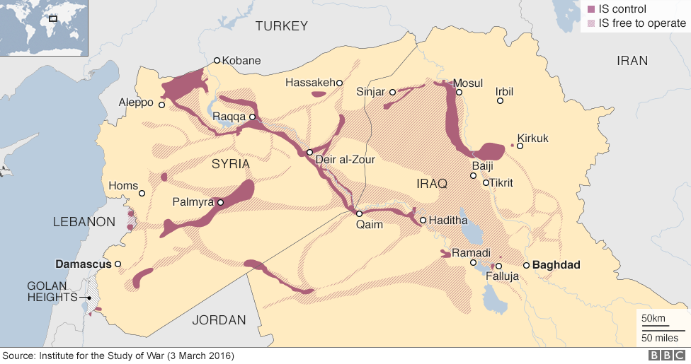
Areas - Civil War

Slide 26
Key issues within Syria
13.5 million people are in need of humanitarian assistance inside Syria
4.8 million Syrians have fled as refugees to neighbouring countries
The Prime Minister announced that the UK will more than double our total pledge to the Syria crisis from £1.12 billion to over £2.3 billion.

Slide 27
Migration
Over 1 million refugees and migrants crossed the Mediterranean into Europe in 2015.
Our Royal Navy assets and Border Force vessels have helped to rescue over 12,500 in the Mediterranean.
Over 153,000 refugees and migrants have crossed the Mediterranean since the start of Jan 2016 to 16 March.

Slide 28
Regional Complexities
There are over 4.8 million refugees in neighbouring countries
Turkey hosts the largest number, over 2.7 million
In Lebanon, Syrian refugees now account for one quarter of the pre-crisis population.

Slide 29
UK refugee solution
We have met our commitment to resettle 1000 Syrian refugees before Christmas, and expect to resettle up to the full commitment of 20,000 Syrians in need of protection by 2020.
The largest driver of irregular migrants from Middle East and North Africa into the EU is currently the Syria crisis as people flee conflict and insecurity.

Slide 30
International response
Our support includes:
Helping to get Syrian refugee children back into education and where possible integrated into public schools, through the No Lost Generation Initiative
Supporting municipal governments and community leaders to provide basic services such as waste collection, water and sewerage services and recreation facilities for both host and refugee communities;
Expanding local labour markets and providing more employment opportunities

